Slide 1
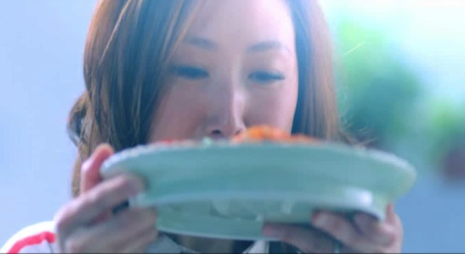
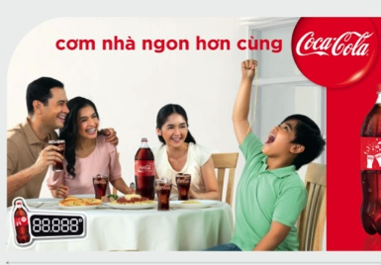


Put Into Practice
Case Study: Coke With Food in Co.opmart & Aeon
THE BUSINESS BRIEF
Capture market share in upsize segment (MS SSD) through building association of Coke being the preferred choice for at home parties, by highlighting “connecting” motivation and delicious upliftment that will complement the 1.5l pack to solidify & own food occasion.
THE OBJECTIVE
Build Coke association with party at home occasion (under The Food umbrella)
THE IDEA: With Coca Cola, family meal is better
THE WORK
TVC and OOH adaptation
In-store Strategy and Messages: different messages have been developed according to zones & shopper needs
In-store Visual and Communication
Above the Line
TV
OOH
In-store
See next 2 slides for how we implement it in-store

Slide 2
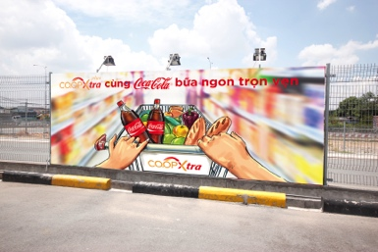
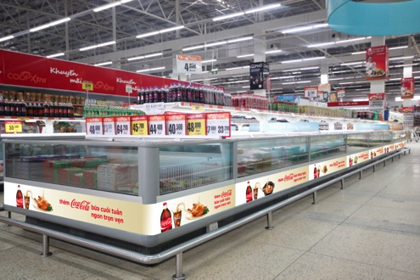
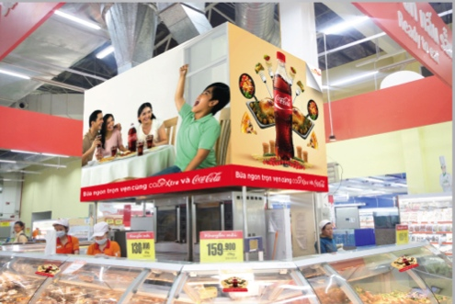
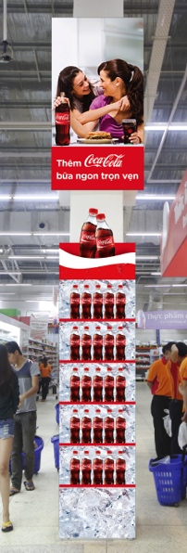
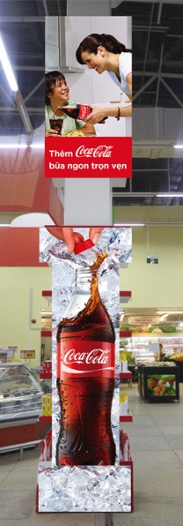
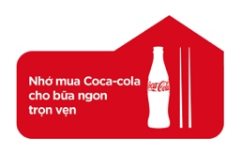

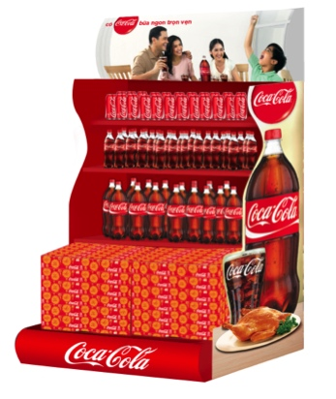
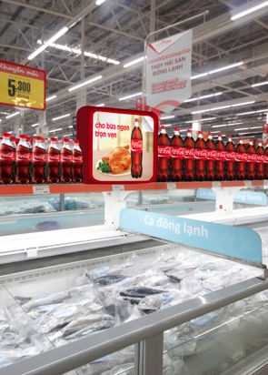
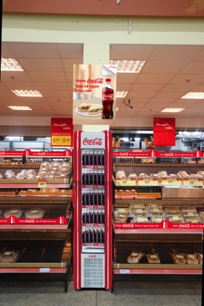
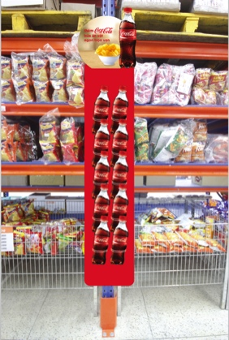

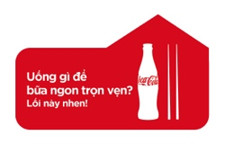


Put Into Practice
Case Study: Coke With Food in Co.opmart & Aeon
With Coca Cola – The weekend meal is more fulfilled
The meal is more fulfilled with Co.op Xtra and Coca Cola
With Co.op Xtra and Coca Cola – The meal is more fulfilled
Floor stickers with different messages lead to the area
With Coca Cola – The meal is more fulfilled
With Coca Cola – The meal is more fulfilled
For the fulfilled meal
With Coca Cola, the snack is even better
TRANSITION ZONE
IMPULSE ZONE

Slide 3
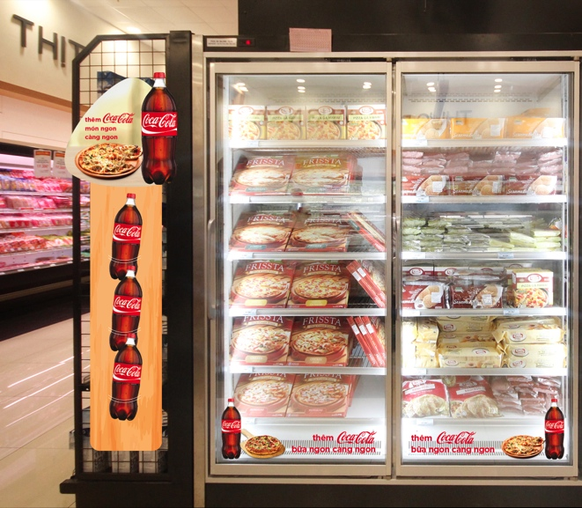
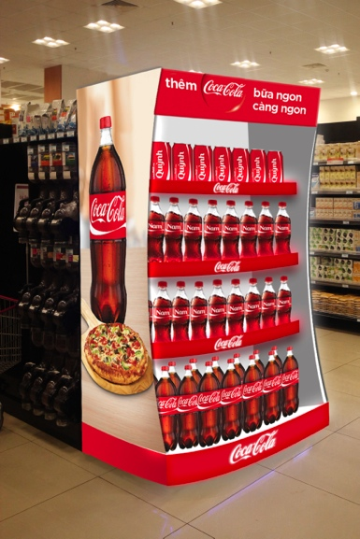
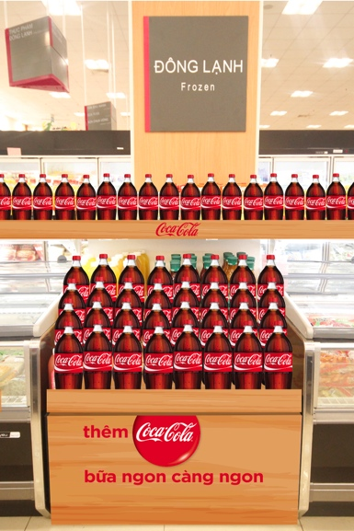
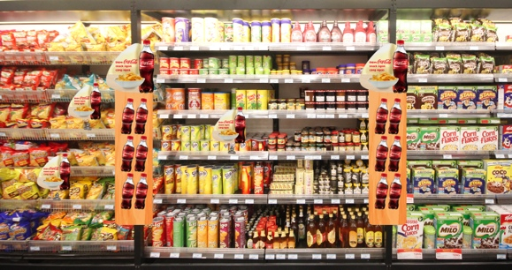
Put Into Practice
Case Study: Coke With Food in Co.opmart & Aeon
With Coca Cola – The food is tastier
With Coca Cola – The meal is more fulfilled
With Coca Cola, the snack is even better
With Coca Cola – The meal is more fulfilled
IMPULSE ZONE

